Slide 1
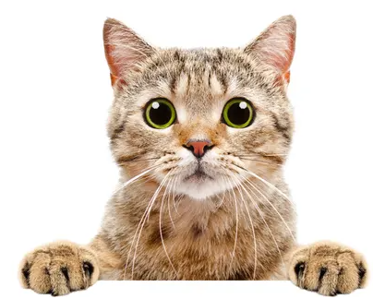
Cat or not a cat?
On each slide, vote whether you think the image is a cat or not

Slide 2

Cat or not a cat?

Slide 3
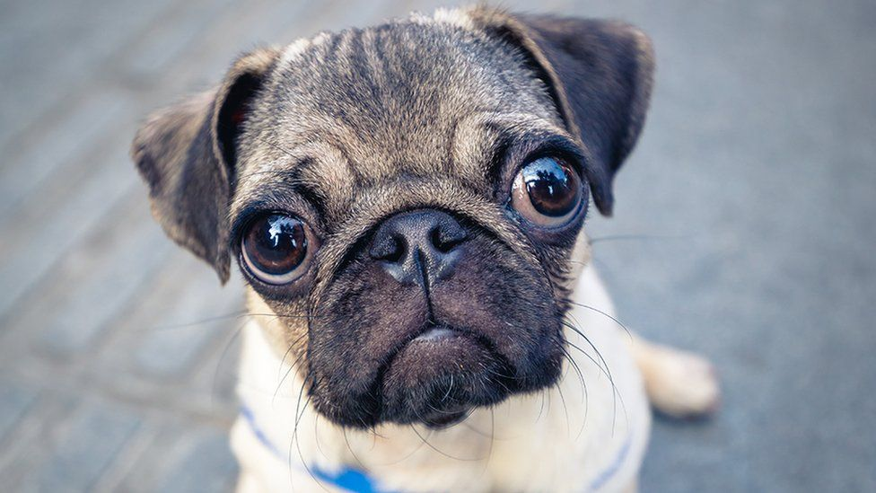
Cat or not a cat?

Slide 4
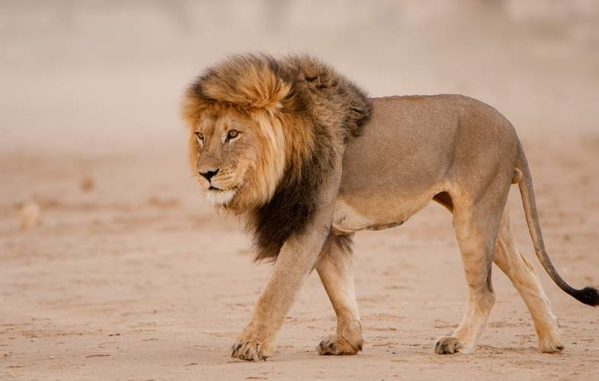
Cat or not a cat?

Slide 5
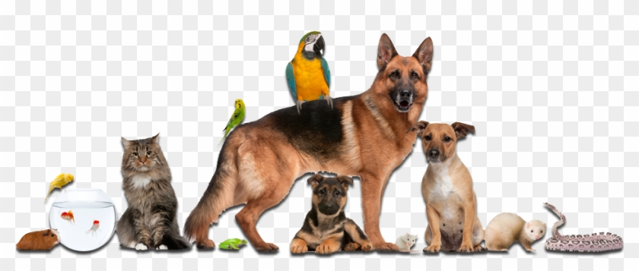
Cat or not a cat?

Slide 6
How’d we do?
Did we do well? Was there disagreement?
Do we need to redefine the question?
What features would help determine whether the image was a cat or not?

Slide 7
Let’s get systematic…
Define 2-3 features for determining whether a picture is a cat or not and use these for determining whether the following images are cats or not

Slide 8
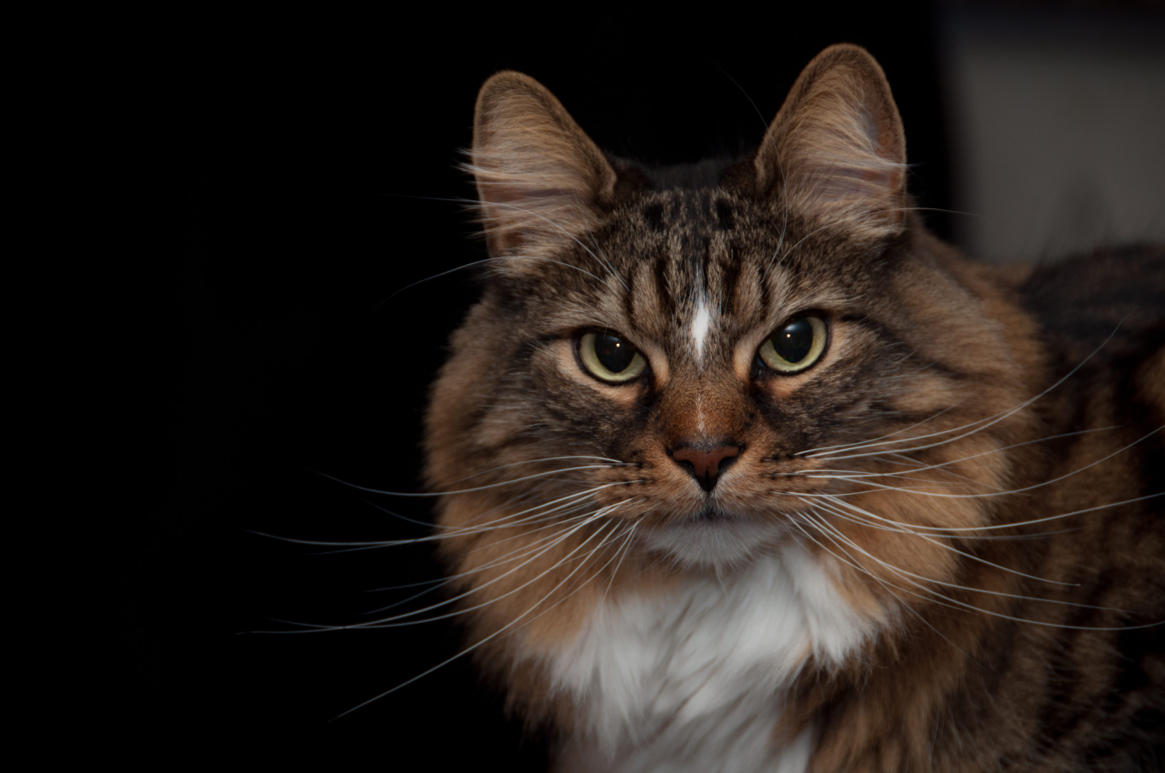
Cat or not a cat?

Slide 9

Cat or not a cat?

Slide 10
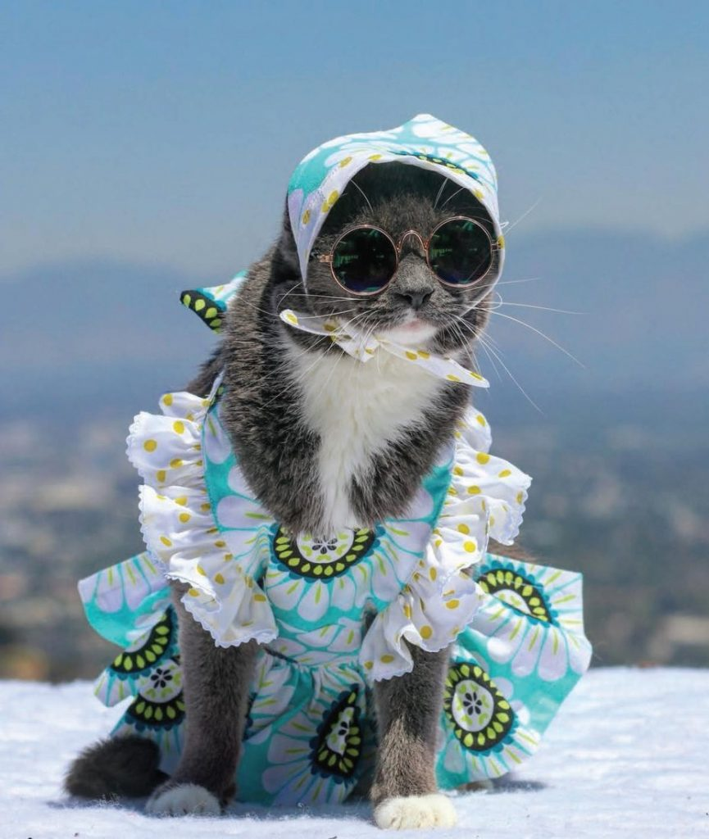
Cat or not a cat?

Slide 11
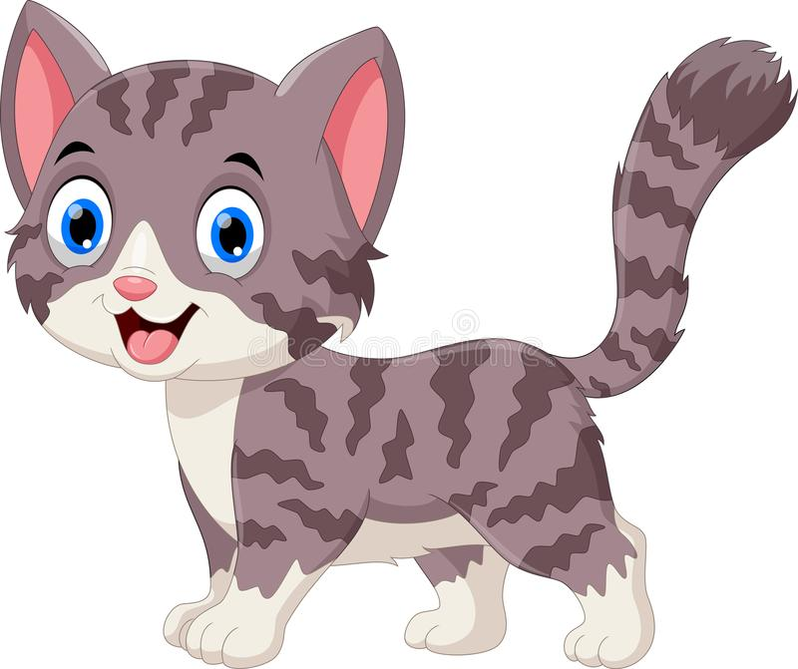
Cat or not a cat?

Slide 12
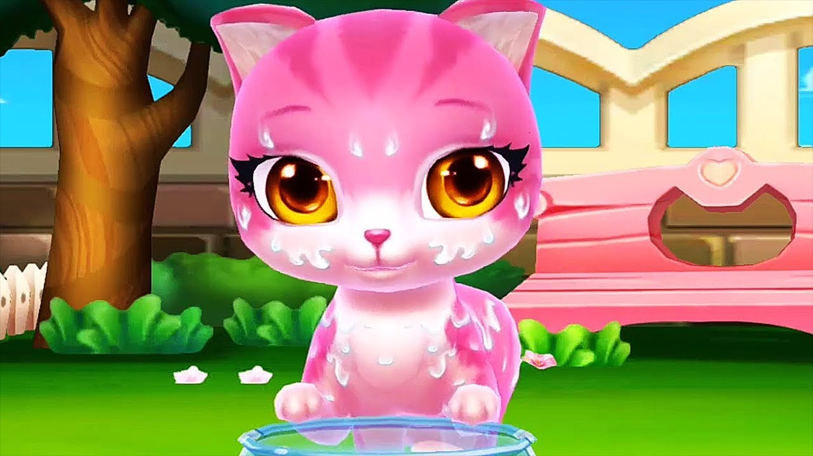
Cat or not a cat?

Slide 13
How’d we do?
Did our features help us classify the images well?
Should any features be modified?
Should any features be added?
Do we need to redefine the question?

Slide 14
Let’s try some new images…
Now let’s try and identify whether an image contains a ‘green light’ at an intersection or not
Define 3 or more features for identifying green lights that will be used for the following images

Slide 15
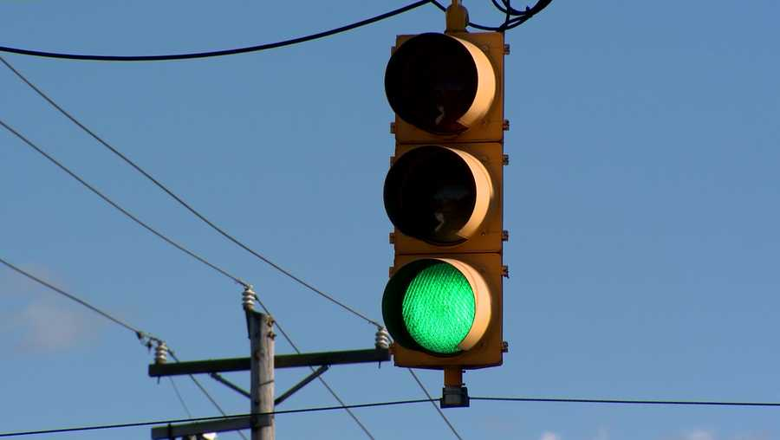
Is it a green light?
Record the results for each image. What features failed? What features worked well?

Slide 16
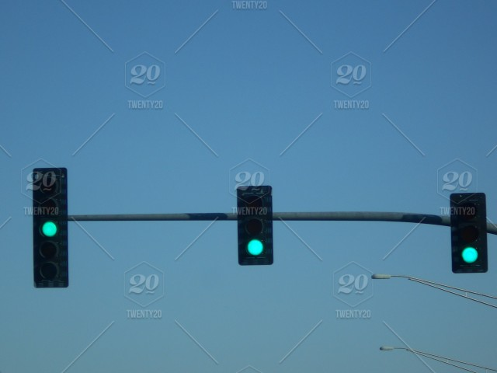
Is it a green light?

Slide 17

Is it a green light?

Slide 18
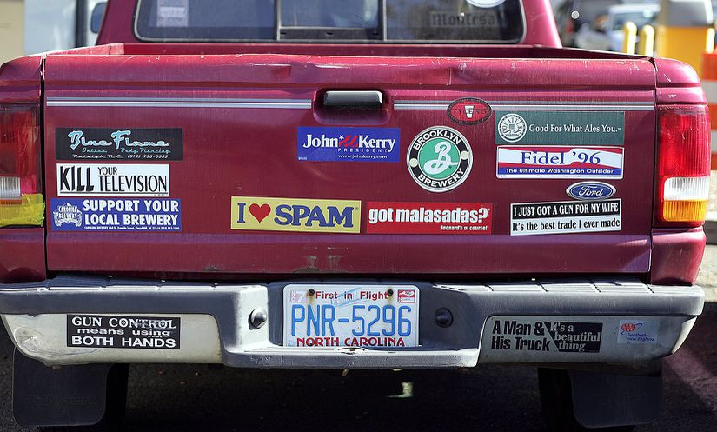
Is it a green light?

Slide 19
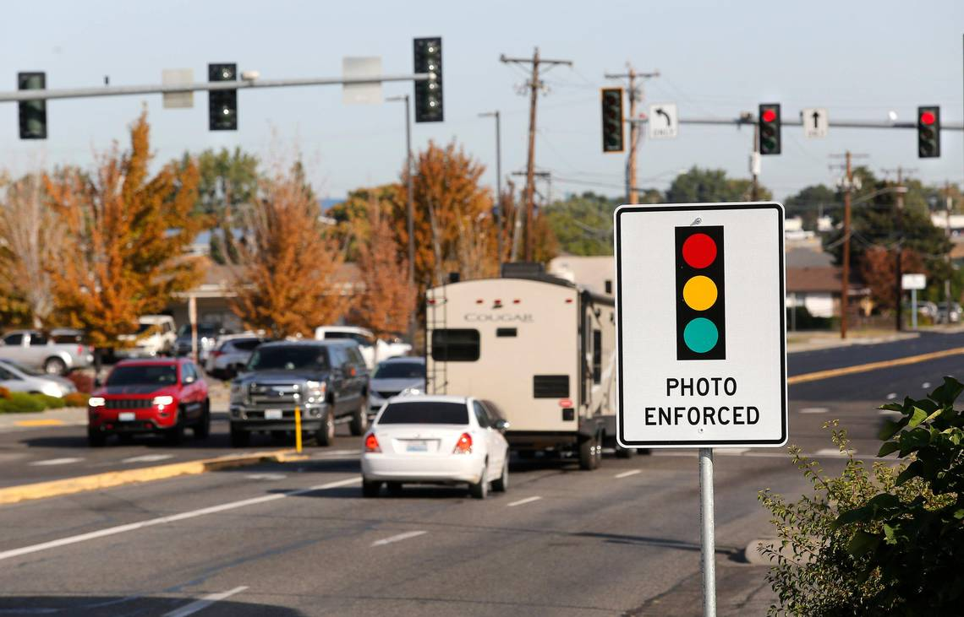
Is it a green light?

Slide 20
How’d we do?
Did our features help us classify the images well?
Should any features be modified?
Should any features be added?
How is the importance of accuracy different between a program that identifies cats and a program that identifies green light?

